Slide 1


Employee Management System
Team 3
11-02-2023
© 2023QuEST Global Services Pte Ltd. The information in this document is the property of QuEST Global Services Pte Ltd. and may not be copied or communicated to a third party or used for any purpose other than that for which it is supplied without the written consent of QuEST Global Services Pte Ltd.
1 | © 2018 QuEST Global Services Pte Ltd. Confidential

Slide 2
Coverage
Overview of the project
Requirement & GUIs
High Level Design
Individual contribution
Challenges faced & how it addressed
Experience gained
2

Slide 3
Overview
Employee Management System is a distributed application developed to maintain details of Employees working in any organization.
It maintains the information about the personal and official details of the employees.
This project aims to simplify the task of maintaining records of the employees of the company.
The main objective of the project is to provide a comprehensive approach towards the management of employee information.
2

Slide 4
Technologies used
Spring boot
Spring framework
Spring data jpa
Java 17
maven
My SQL Server
5 | © 2023QuEST Global Services Pte Ltd.
5
Confidential

Slide 5
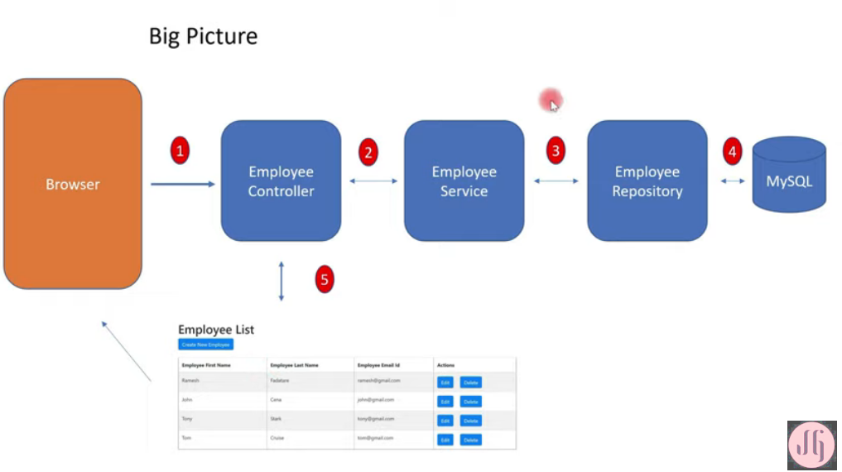
High Level Design
4 | © 2023 QuEST Global Services Pte Ltd.
Confidential

Slide 6
Software Requirements
Operating System: Windows 10/11
Spring Framework
Others: Java, Spring tool Suite IDE
5 | © 2023QuEST Global Services Pte Ltd.
5
Confidential

Slide 7
Functional Requirements.
User
Admin
5 | © 2023 QuEST Global Services Pte Ltd.
5
Confidential

Slide 8
Functional Requirements.
Admin - Represents the person who has access to the system and can perform actions such as adding, deleting, and updating employees.
Use cases for admin:
Add Employee: Admin can add new employees to the system by providing their personal and professional details.
Delete Employee: Admin can delete employees from the system who are no longer working for the company.
5 | © 2023 QuEST Global Services Pte Ltd.
5
Confidential

Slide 9
Functional Requirements.
Update Employee: Admin can update the details of existing employees in the system.
View Employee: Admin can view the details of employees in the system.
Relationships:
The Admin is associated with all of the use cases, indicating that they are the ones who can perform these actions.
The use cases are connected to each other, indicating that they are all related to the employee management system.
5 | © 2023 QuEST Global Services Pte Ltd.
5
Confidential

Slide 10
Functional Requirements.
User - Represents the person who can log in through his credentials and register if he is a new user.
Use cases for user:
Log in: User can login by entering their required user credentials like user name and password.
Register: If user is new he can register by providing his personal and professional details required
Details: The employee can update his own details.
5 | © 2023 QuEST Global Services Pte Ltd.
5
Confidential

Slide 11
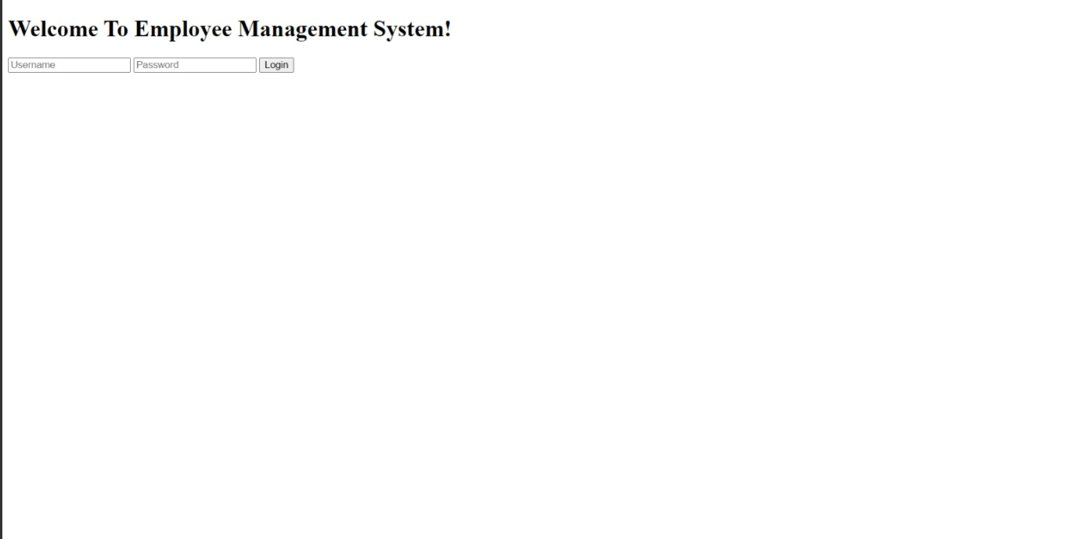
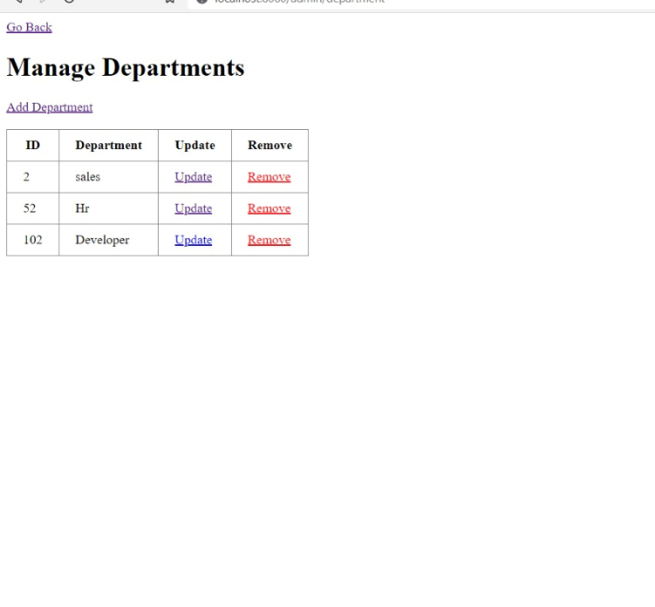
GUI’s

Slide 12
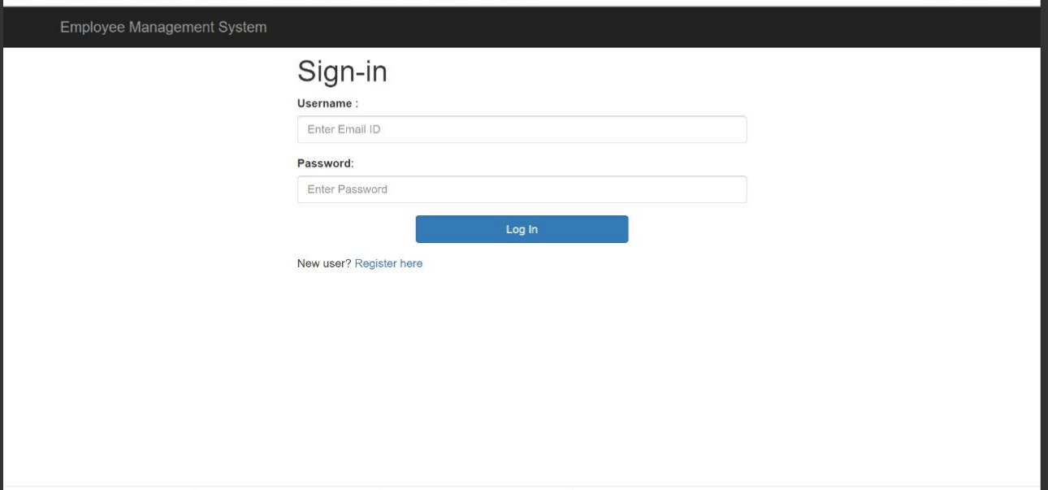
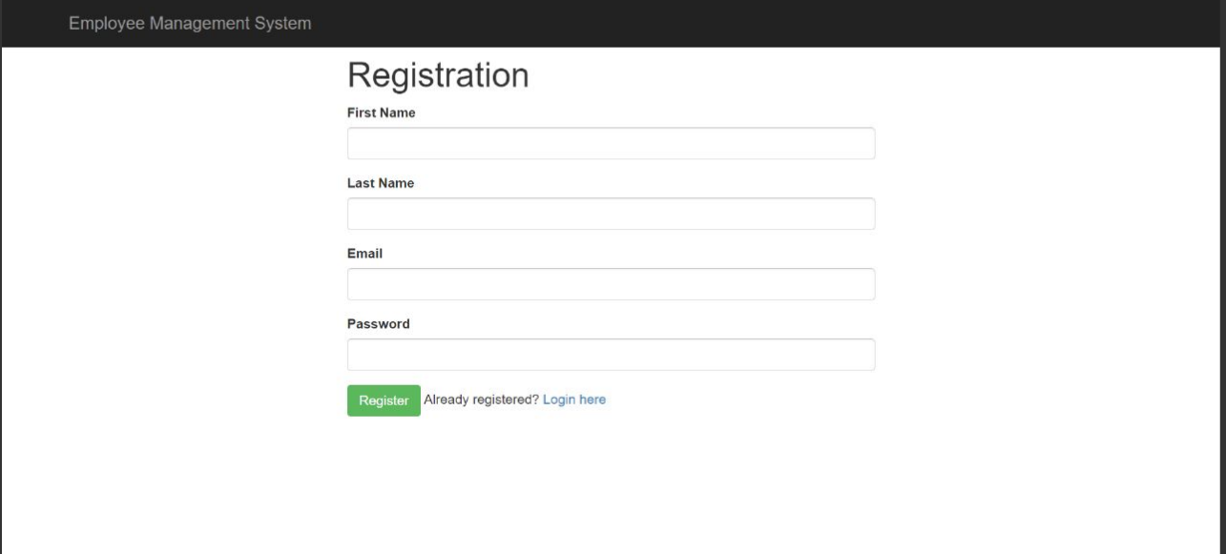
GUI’s

Slide 13
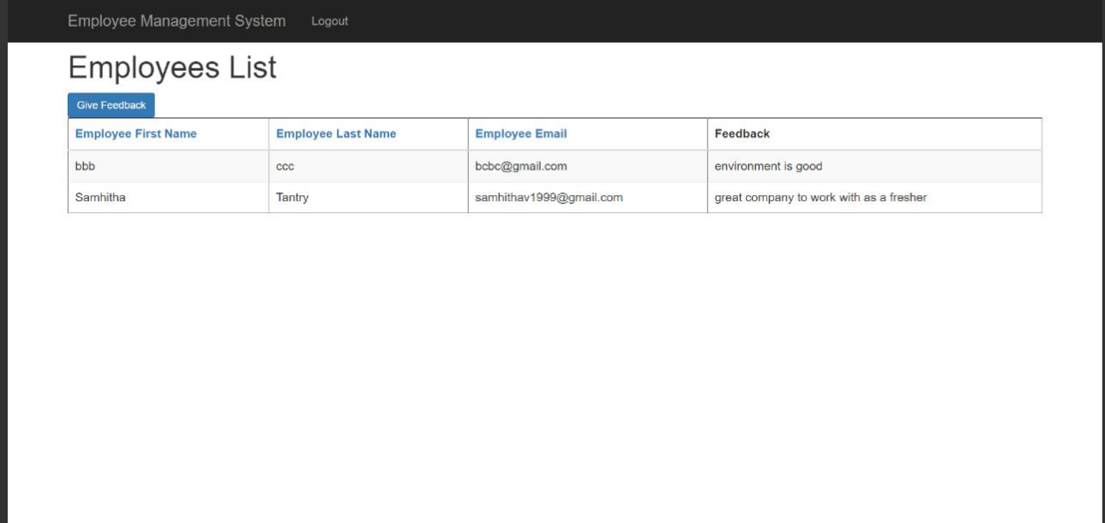
GUI’s

Slide 14
Sample Code Snippets
spring.datasource.url=jdbc:mysql://localhost:3306/ems_db
spring.datasource.username=root
spring.datasource.password=Lebronjames2308!!
spring.datasource.driver-class-name=com.mysql.cj.jdbc.Driver
spring.jpa.hibernate.ddl-auto=update
spring.jpa.show-sql=true
spring.jpa.properties.hibernate.format_sql=true
debug=true

Slide 15
Sample Code Snippets
package com.quest.ems.repository;
import org.springframework.data.jpa.repository.JpaRepository;
import com.quest.ems.models.Employee;
public interface EmployeeRepository extends JpaRepository<Employee, Integer>{
}

Slide 16
Individual contribution
Mahesh :
Department Module
All CRUD Operations for department.
Priyanka:
Employee Module
Provide feature to add his own details.
Samhitha:
Feedback Module- Sign up and Log in
It provides facility for the employees to provide feedback.
Rutuja:
User Module
Admin - log in
Update the employee data

Slide 17
Challenges faced.
Intially we were facing issues connecting to database .
Issues with mapping between the pages .
Problem with proper usage of annotations .
Problem in rectifying the White label error.
| © 2023 QuEST Global Services Pte Ltd.
10

Slide 18
Experience gained
Gained experience in learning Spring Framework and usage of STS IDE.
Learnt the database connectivity and performing basic CRUD Operations.
Getting used to design a user-friendly GUI.
Working efficiently in the group.
| © 2023 QuEST Global Services Pte Ltd.
10

Slide 19




Thank You
© 2023 QuEST Global Services Pte Ltd. The information in this document is the property of QuEST Global Services Pte Ltd. and may not be copied or communicated to a third party or used for any purpose other than that for which it is supplied without the written consent of QuEST Global Services Pte Ltd.
13 | © 2018 QuEST Global Services Pte Ltd. Confidential

